Slide 1

Association for Computational Linguistics (ACL) 2019
Main topics of this conference are related to dealing problems involving natural language and computation
Example topics:
Dialogue and Interactive Systems
Tagging, Chunking, Syntax and Parsing
Information Extraction and Text Mining
Machine Translation
Bias in Language Processing
etc.
Also covers broader topics such as Machine Learning, Social Media and Applications

Slide 2

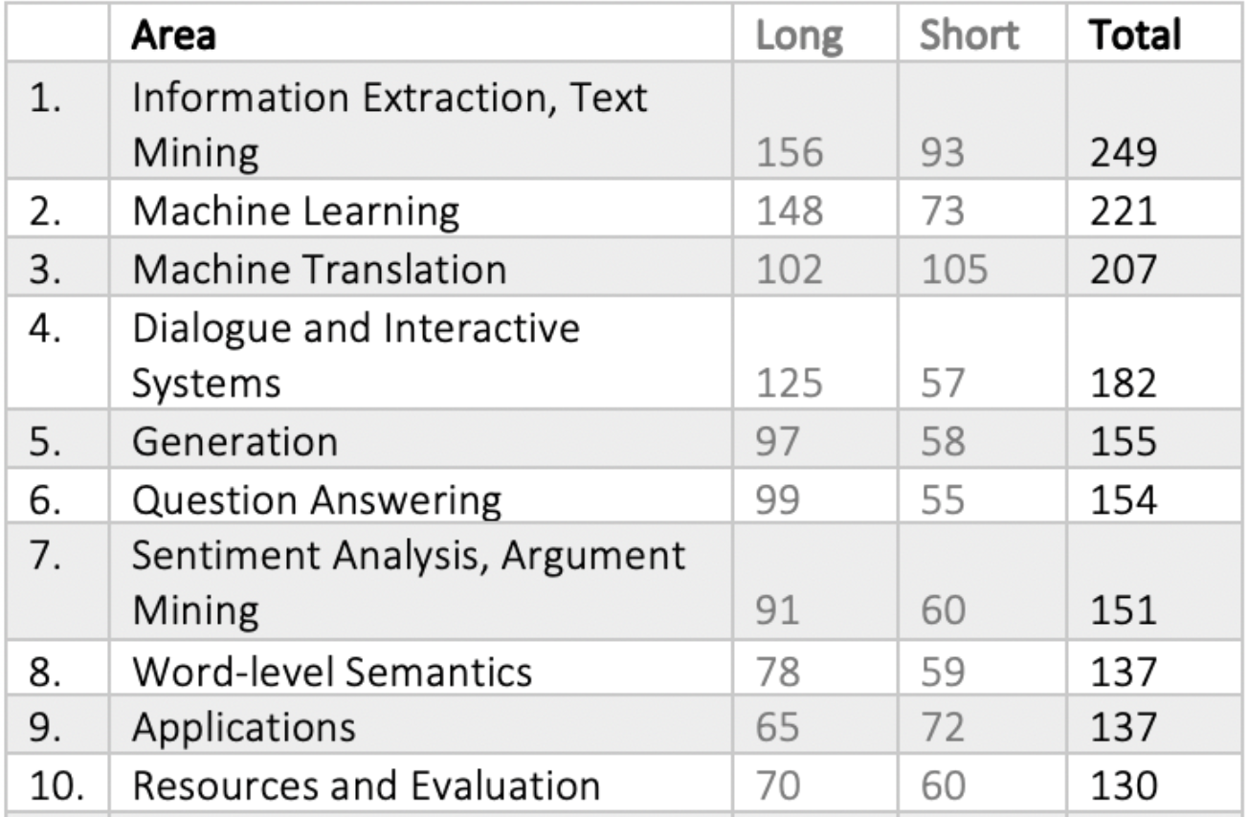
ACL 2019: Location & Data Summary
Held in Florence, Italy
July (28th)/August(2nd) 2019
~ 3300 attendees
Main Track: 447/1740 accepted ~ 25.7% %
Short Papers: 213/1165 ~ 18,3 %
All the major industry players were there:
Apple, Facebook, Microsoft, Amazon, Google, Tencent, Baidu...

Slide 3
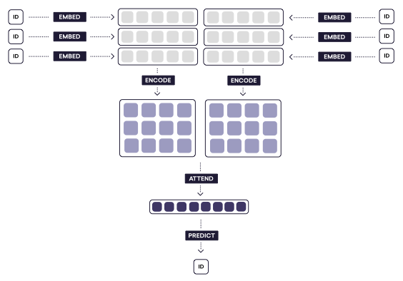
Trends in NLP
In 2018/2019 NLP has experienced and explosive and rapid growth
Similar to the computer vision field in 2011 with ImageNet (Krizhevsky et. al.)
Before 2018, NLP was:
Embed -> encode -> attend -> predict -> SOTA results in many tasks
2018 -> enter Pretrained Representations
GPT, ELMO, BERT…
Off-the-self pretrained model on huge datasets -> fine-tune tasks in small corpus -> even better SOTA results
2019 -> At ACL this year, the “BERTology” trend was kept
Lots of papers studying the properties of BERT or building on top of it, including:
Multi-Task Deep Neural Networks for Natural Language Understanding (MS)
Transformer XL (CMU, Google)

Slide 4
Bert Limitations and New Benchmarks
HellaSwag: Can a Machine Really Finish Your Sentence? (Allen Inst. AI)
Questions the current benchmarks for certain tasks, and suggests a new path forward for NLP research, in which benchmarks co-evolve with the evolving SotA in an adversarial way, so as to present ever-harder challenges
Human vs. Muppet: A Conservative Estimate of Human Performance on the GLUE Benchmark (NYU)
Trains BERT in limited-data regimes concluding that low-resource sentence classification remains still a challenge for modern NN approaches to text understanding.
SuperGlue (NYU, FB) New benchmark for NLU
Many other papers on biases and model interpretability

Slide 5
Trends in NLP: Beyond Pre-trained Language Models
Critique of Pre-trained LMs: what they learn is relatively unconstrained
Many papers were trying to tackle this question at ACL by infusing information from other grounded knowledge sources:
COMET : Commonsense Transformers for Automatic Knowledge Graph Construction (MS)
Learn from LM to add new nodes and edges to a knowledge graph of commonsense bases.
Explain Yourself! Leveraging Language Models for Commonsense Reasoning (Salesforce)
Collect human explanations for commonsense reasoning in the form of NL sequences -> Highlight annotations in a new dataset called Common Sense Explanations (CoS-E) -> Use CoS-E to train LMs to automatically generate explanations
Barack’s Wife Hillary: Using Knowledge Graphs for Fact-Aware Language Modeling
Addresses LM’s inability to correctly reason words that rarely appear in the training data, by selectively copying facts from a knowledge graph relevant to an underlying context
ERNIE: Enhanced Language Representation with Informative Entities (Tsinghua)
Use knowledge facts to create a new framework for language representation models (enhanced BERT, yes again) that align better with reality
Explainable Reasoning over Knowledge Graphs for Recommendation
A model with knowledge-aware path recurrent network which is able to generate a representation for each path by composing semantics of entities and relations.

Slide 6
Trends in NLP: Question Answering and Semantics
Latent Retrieval for Weakly Supervised Open Domain Question Answering (Google)
Open domain QA system where retriever & reader are jointly learned end-to-end using only question-answer pairs, without any IR system (BERT-based, of course)
Open Domain Question Answering Using Early Fusion of Knowledge Bases and Text (CMU)
Open-domain QA extracting answers from a question-specific subgraph containing text + KB entities and relations, which is appropriate when an incomplete KB is available with a large text corpus
Improving Question Answering over Incomplete KBs with Knowledge-Aware Reader (IBM)
A model learns to aggregate answer evidence from an incomplete KB and a set of retrieved text snippets
Multi-Hop Paragraph Retrieval for Open-Domain Question Answering (Technion)
To answer a question, this method retrieves multiple supporting paragraphs, nestled amidst a large knowledge base, assuming that contain the necessary evidence
XQA: A Cross-lingual Open-domain Question Answering Dataset (Tsinghua University)

Slide 7
ACL 2019: Keynotes & Best Papers
Invited Talks:
Simultaneous Translation: Recent Advances and Remaining Challenges
Liang Huang (Oregon State University)
Loquentes Machinae: Technology, Applications and Ethics of Conversational Systems
Pascale Fung (HKUST)
Best paper:
Bridging the Gap between Training and Inference for Neural Machine Translation.
Wen Zhang, Yang Feng, Fandong Meng, Di You and Qun Liu
Best short paper:
Do you know that Florence is packed with visitors? Evaluating state-of-the-art models of speaker commitment.
Nanjiang Jiang and Marie-Catherine de Marneffe

Slide 8
ACL 2019: Outstanding Papers & Workshops
Outstanding Papers:
Emotion-Cause Pair Extraction: A New Task to Emotion Analysis in Texts. Rui Xia and Zixiang Ding
A Simple Theoretical Model of Importance for Summarization. Maxime Peyrard
Transferable Multi-Domain State Generator for Task-Oriented Dialogue Systems. Chien-Sheng Wu, Andrea Madotto, Ehsan Hosseini-Asl, Caiming Xiong, Richard Socher and Pascale Fung
We need to talk about standard splits. Kyle Gorman and Steven Bedrick
Zero-shot Word Sense Disambiguation using Sense Definition Embeddings. Sawan Kumar, Sharmistha Jat, Karan Saxena and Partha Talukdar
Other Interesting Workshops:
Fourth Conference on Machine Translation (WMT19)
TyP-NLP, Typology for Polyglot NLP
BlackboxNLP 2019: Analyzing and interpreting neural networks for NLP
ArgMining 2019: The 6th International Workshop on Argument Mining
NLP for Conversational AI
The First International Workshop on Designing Meaning Representations (DMR)
Joint Workshop on Multiword Expressions and WordNet (MWE-WN 2019)
4th Workshop on Representation Learning for NLP (RepL4NLP-2019)
Deep Learning & Formal Languages: Building Bridges
The Third Workshop on Abusive Language Online

Slide 9
Question Floating in the Air
Are today’s models solving datasets or the tasks they really need to solve?

